Slide 1

COMPETENCIAS DIGITALES PARA EL Sector de Exhibición Cinematográfica
Jornada Innovación y Formación en la Exhibición Cinematográfica
Julio Navío Marco
Director de la Cátedra Europea Jean Monnet de Economía Digital. Profesor titular UNED
Financiado por la Unión Europea. Los puntos de vista y opiniones expresados son únicamente los del autor o autores y no reflejan necesariamente los de la Unión Europea o de la Agencia Ejecutiva Europea de Educación y Cultura (EACEA). Ni la Unión Europea ni la EACEA pueden ser consideradas responsables de ellos

Slide 2
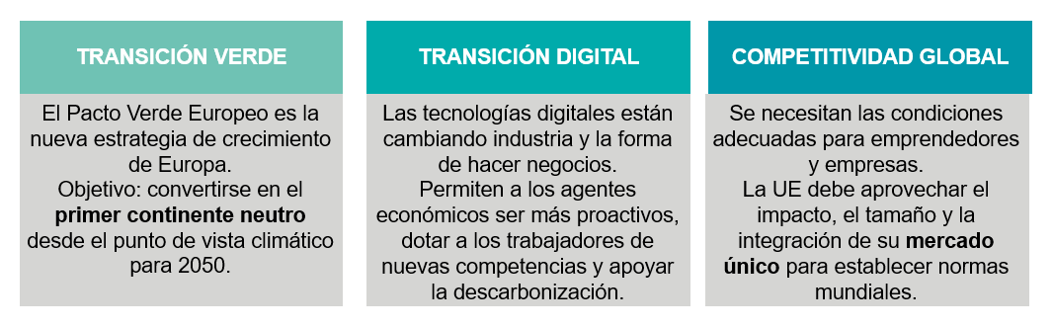
Importancia para la Unión Europea
“En este mundo en pleno cambio, liderar la transición digital y sostenible es la idea fundamental que mueve a esta Comisión. Es la tarea y la oportunidad de nuestra generación. De ahí que desde el primer día nos hayamos mostrado resueltos a avanzar deprisa para construir una Europa justa y próspera, ecológica y digital, que dure para nuestros hijos”
“Avanzar rápido, construir para perdurar: la nueva generación de Europa" Ursula von der Leyen, presidenta de la Comisión Europea
Fuente: Comisión Europea

Slide 3
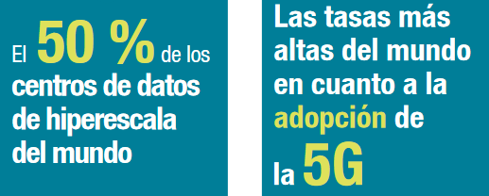
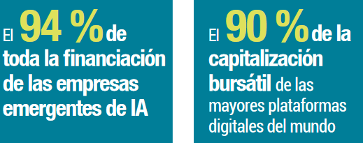
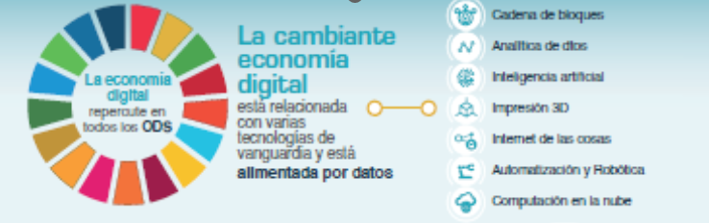
EE.UU y China van por delante de Europa
FUENTE::
UNCTAD DIGITAL ECONOMY REPORT 2021: Cross-border data flows and development: For whom the data flow
Notes:
Climate change and environmental degradation are an existential threat to Europe and the world. To overcome these challenges, the European Green Deal will transform the EU into a modern, resource-efficient and competitive economy, ensuring:
no net emissions of greenhouse gases by 2050
economic growth decoupled from resource use
no person and no place left behind
The European Green Deal is also our lifeline out of the COVID-19 pandemic. One third of the €1.8 trillion investments from the NextGenerationEU Recovery Plan, and the EU’s seven-year budget will finance the European Green Deal.
The European Commission has adopted a set of proposals to make the EU's climate, energy, transport and taxation policies fit for reducing net greenhouse gas emissions by at least 55% by 2030, compared to 1990 levels. More information on Delivering the European Green Deal.

Slide 4
Puntos cardinales
Notes:
https://ec.europa.eu/info/sites/info/files/summary-data-governance-data-policies_en.pdf

Slide 5
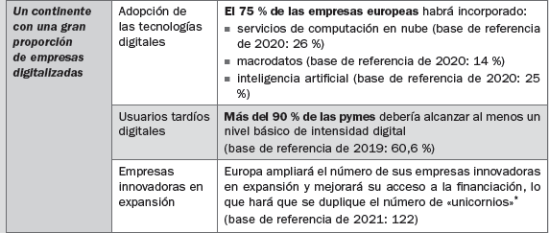
Competencias digitales para profesionales y empresas
Notes:
https://ec.europa.eu/info/strategy/priorities-2019-2024/europe-fit-digital-age/digital-services-act-ensuring-safe-and-accountable-online-environment_en
La Ley de Servicios Digitales mejora significativamente los mecanismos de eliminación de contenidos ilícitos y protección efectiva de los derechos fundamentales de los usuarios, incluida la libertad de expresión. Además, la Ley introduce una mayor supervisión pública de las plataformas, en particular las que llegan a más del 10% de la población de la UE.
En concreto, esto implica:
medidas para luchar contra los bienes, servicios o contenidos ilícitos online, tales como un mecanismo para que los usuarios denuncien este tipo de contenidos y para que las plataformas cooperen con "alertadores fiables"
nuevas normas sobre trazabilidad de empresas usuarias en los mercados online para ayudar a identificar a los vendedores de bienes o servicios ilegales
garantías eficaces para los usuarios, incluida la posibilidad de impugnar las decisiones de los moderadores de contenidos de las plataformas
medidas de transparencia para las plataformas online, inclusive sobre los algoritmos utilizados para las recomendaciones
obligación para las plataformas muy grandes de evitar abusos de sus sistemas gracias a medidas basadas en el riesgo y auditorías independientes de su gestión de riesgos
acceso de los investigadores a los datos clave de las plataformas más grandes a fin de comprender cómo evolucionan los riesgos online
estructura de supervisión adecuada a la complejidad del ciberespacio: los países de la UE desempeñarán el papel principal, con el apoyo de un nuevo Consejo Europeo de Servicios Digitales; en el caso de las plataformas muy grandes, supervisión y ejecución reforzadas por parte de la Comisión.

Slide 6
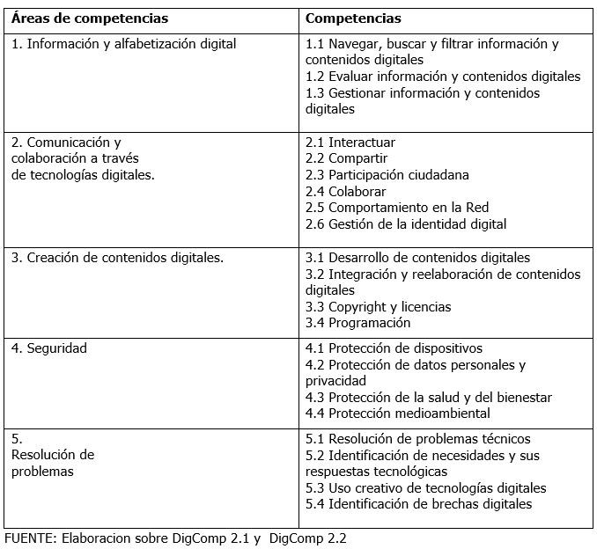
Marco Europeo
El Marco Europeo de Competencias Digitales para la Ciudadanía, también conocido como DigComp, es la herramienta diseñada para mejorar y valorar las competencias digitales de los ciudadanos en el marco de UE
Notes:
IMPLICATIONS FOR POLICIES
Ý Promote the access to data for innovation in Europe while providing clarity about principles and regulations governing privacy and the ethical use of data.
Ý The increase in concentration has implica- tions for business dynamism, competition policy, and wealth distribution. Pro- mote competition policies ‘fit for the digital age’ and measure and assess the impact of the ‘digital economy’.
Ý With innovation moving at unprecedented speeds, policymaking also needs to react faster to the changing contexts. Also, new rules are needed to ensure digital business activities are taxed in a fair and growth- friendly way.
Ý
Ý Create the right framework conditions for digital firms in the EU to be able to succeed and compete globally in the markets providing digital technologies that are underpinning digitalisation.

Slide 7
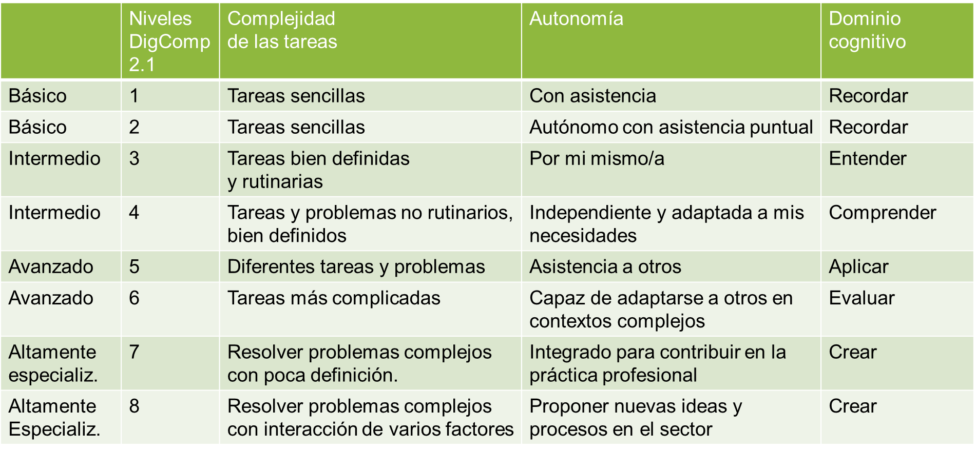
Niveles de aptitud
Notes:
IMPLICATIONS FOR POLICIES
Ý Promote the access to data for innovation in Europe while providing clarity about principles and regulations governing privacy and the ethical use of data.
Ý The increase in concentration has implica- tions for business dynamism, competition policy, and wealth distribution. Pro- mote competition policies ‘fit for the digital age’ and measure and assess the impact of the ‘digital economy’.
Ý With innovation moving at unprecedented speeds, policymaking also needs to react faster to the changing contexts. Also, new rules are needed to ensure digital business activities are taxed in a fair and growth- friendly way.
Ý
Ý Create the right framework conditions for digital firms in the EU to be able to succeed and compete globally in the markets providing digital technologies that are underpinning digitalisation.

Slide 8

Financiación Europea para formarse
Notes:
The European Social Fund Plus will support EU Member States to improve the quality, effectiveness and labour market relevance of national education and training systems to support the acquisition of key competences, including digital skills. It will also promote upskilling and reskilling opportunities for all, placing a particular emphasis on digital skills.
The European Global Adjustment Fund will support training, which will all have a digital skills component, to help laid-off workers find another job or set up their own business.
Erasmus+ will support digital learning from early childhood to vocational education and university education. It will also continue to support the acquisition of digital skills through cross-border experiences.
Horizon Europe will finance grants for master, PhD and post-graduate research activities in all fields including digital through Marie Skłodowska-Curie actions as well as the European Institute of Innovation & Technology.
The Recovery and Resilience Facility strongly encourages Member States to include in their plans investment greater support to the development of digital skills.
European Skills Agenda and the Digital Education Action Plan
The new European Skills Agenda underlines the importance of lifelong learning, lays down objectives for the skills for jobs in the digital and green transitions and it mobilises companies, social partners and organisations to take meaningful actions.
Making education and training fit for the digital age is the aim of the Digital Education Action Plan (2021-2027). It calls on Member States and stakeholders to work together to ensure a high-quality, inclusive and accessible digital education in Europe. The Action Plan has two long-term strategic priorities. The first focuses on supporting the development of a high-performing digital education ecosystem, by for example supporting Gigabit connectivity of schools and digital transformation plans at all levels of education and training. The second priority focuses on enhancing digital skills and competences, by for example developing guidelines for teachers to foster digital literacy and tackling disinformation as well as targeting advanced digital skills development through Digital Opportunity Traineeships.
The Digital Skills and Jobs Coalition contributes fully to the objectives of both the Skills Agenda and the Digital Education Action Plan and will continue to play a vital role in mobilising the community and bridging the digital skills gap in Europe. The forthcoming Digital Skills and Jobs Platform will be a one-stop-shop for digital skills trainings and resources in Europe. It will also link the national coalitions together.

Slide 9

¡Gracias!
Julio Navío Marco
Financiado por la Unión Europea. Los puntos de vista y opiniones expresados son únicamente los del autor o autores y no reflejan necesariamente los de la Unión Europea o de la Agencia Ejecutiva Europea de Educación y Cultura (EACEA). Ni la Unión Europea ni la EACEA pueden ser consideradas responsables de ellos.

